Slide 1
XEHDI-WD
Brief Profile Proposal for 2012/13
presented to the
Patient Care Coordination (PCC)
Planning Committee
Lisa R. Nelson
October, 2012

Slide 2
The Problem
There is a need to coordinate care for children with hearing loss and risk of hearing loss
Standards have been developed for the component information collected at individual steps of the detection and intervention process, but the coordination of the information collection across the workflow has not been standardized.
  Pulse Oximetry Integration (POI)
  Early Hearing Care Plan (EHCP)
  Quality Measure Execution for EHDI (QME-EHDI)
Industry Readiness
  1-2 years prior Connectathon testing and Show Case participation
  Industry Pilot in Fall, 2012
What is the risk of this proposal not being undertaken this cycle?
  Silo development
  Miss meeting requirements resulting from the bigger picture

Slide 3
Use Case
Coordination of Newborn hearing screening and short-term care plan guidance (up to 3 years of age)
  Newborn screening at the birthing facility using devices with a current approved physiologic measures of auditory function
  Computation of the hearing screening outcomes report
  Generation of the early hearing care plan (EHCP)
  Provision of the EHCP recommendations to pediatricians to guide hearing care
  Quality assessment on the hearing screening and short-term care follow-up.

Slide 4
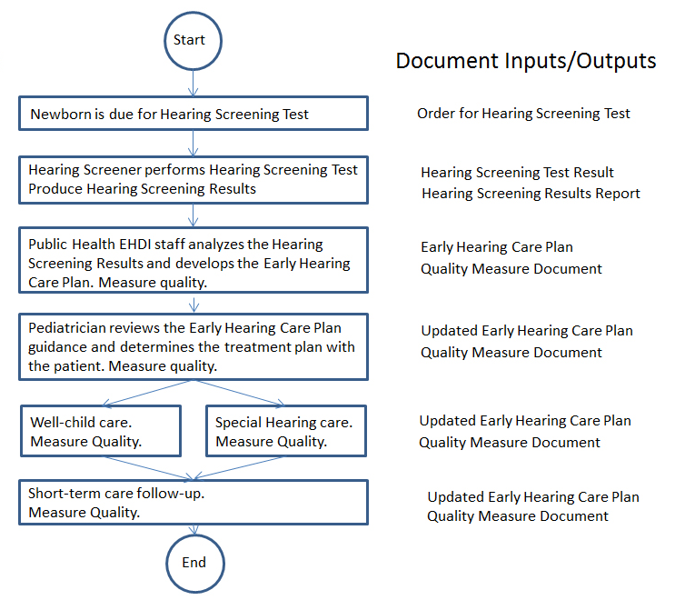
Workflow Steps

Slide 5
Proposed Standards & Systems
What standards and/or systems should be considered in addressing this proposal?
  Systems
    EHR
    EHDI-IS
    Physician EMR
    Public Health
  Standards
    Hearing Screening Results
    Early Hearing Care Plan
    QME-EHDI patient level report
    Early Hearing Care Plan updates
Alternatives:
  Retrieve Process for Execution (RPE)
    Not as clear a fit
    Fewer examples of implementing the profile

Slide 6
Discussion
Level of development effort: Major
Profile editor: Lisa Nelson
Organizational support
  Public Health Data Standards Consortium
  Oz Systems
  CDC
Close coordination and information sharing expected with QRPH domain
Profile development within PCC essential for success
  Economies of scale with other XDW profile development
  Achieve greater consistency across XDW implementations

